Slide 1
Antenna design update, April 15
John Cumner, Quentin Gueuning

Slide 2
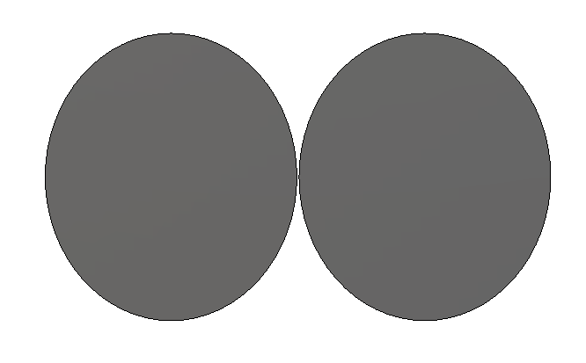
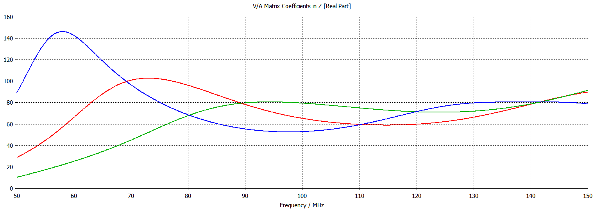
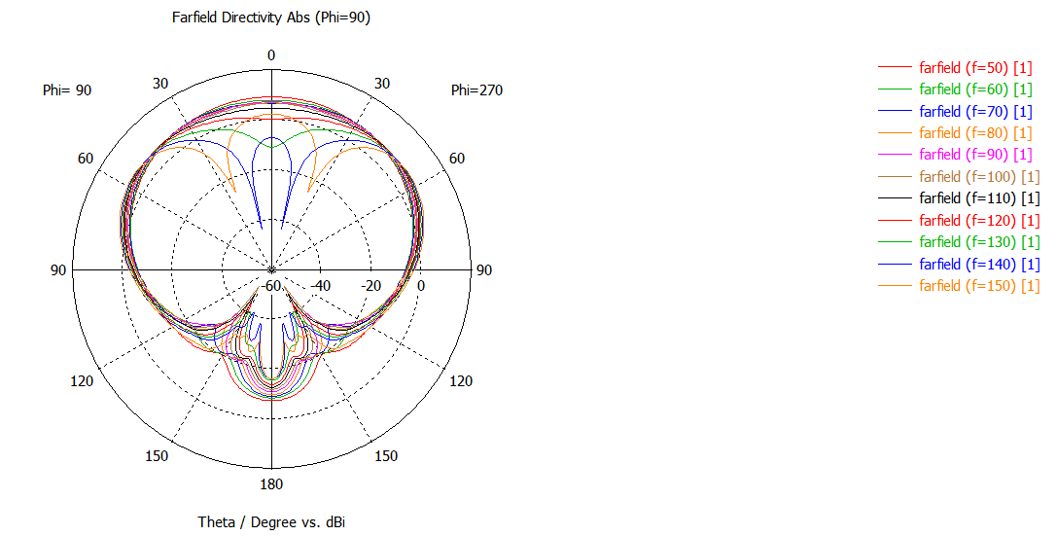
Elliptical dipole
Cumner
Impedances for a range of diameters:
1600/1400mm
1050/1330mm (Farfields shown)
1000/800mm
Farfields broadly similar, some increased smoothness for smaller dipoles
10m ground plane
~10dB backwards, beams uniformity deteriorates at ~100MHz

Slide 3
Elliptical dipole
Cumner
PROs | CONs
Simple design | Requires ground plane
Flat input impedance | Requires balun
Low input impedance | Beam separates at top end of frequency band
Possible to expand to second polarization

Slide 4
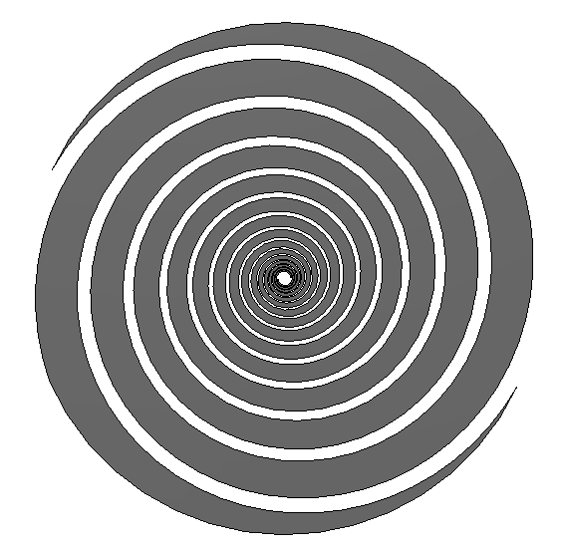
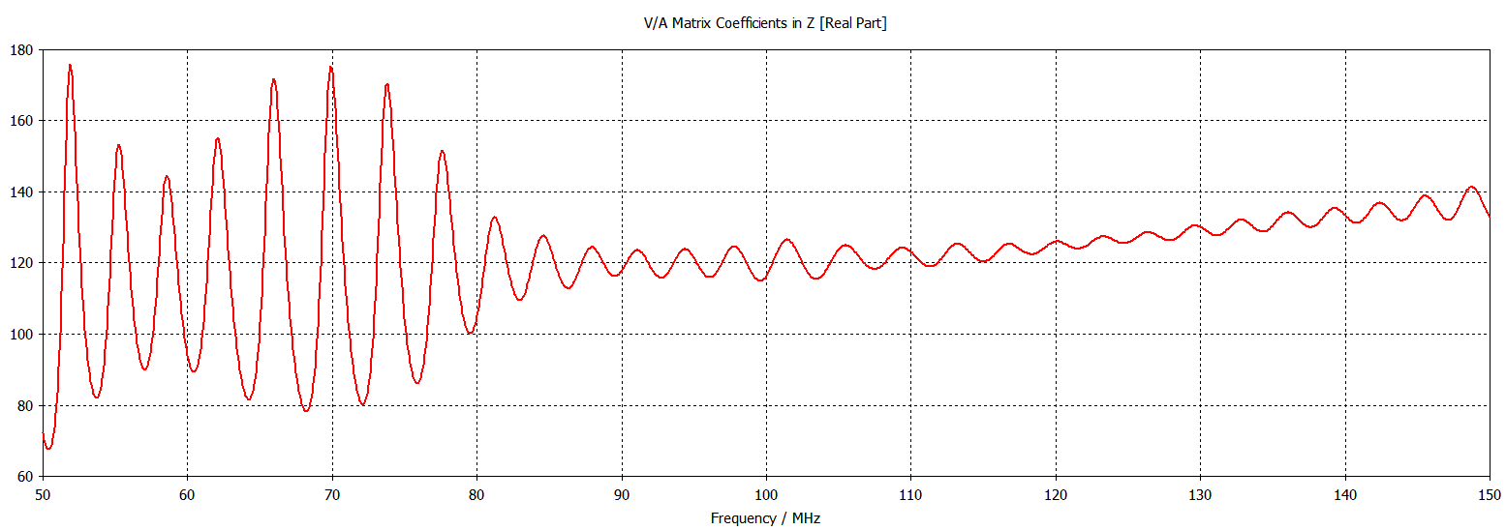
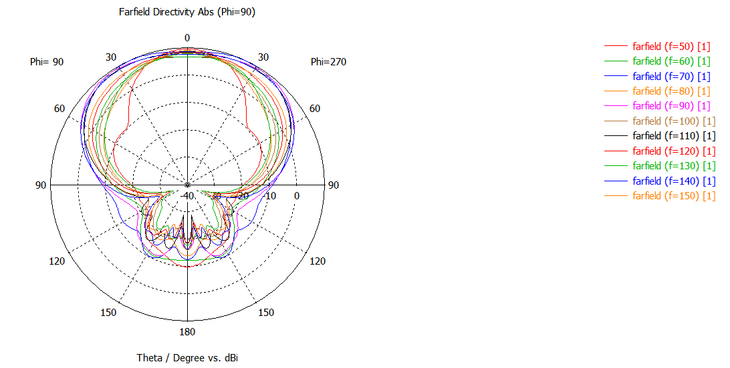
Flat log spiral
Cumner
Quite a resonant impedance, this is from the size of the antenna.
Impedance about ~120Ω
10-20dB backwards. Closer beam uniformity, although rotational features can be seen.

Slide 5
Flat log spiral
Cumner
PROs | CONs
Wide sky beam | Requires ground plane
Covers full band | Requires balun
Relatively low input impedance | Beam rotates with frequency
 | Spiky input impedance
Could be designed without,
have not yet looked into it

Slide 6
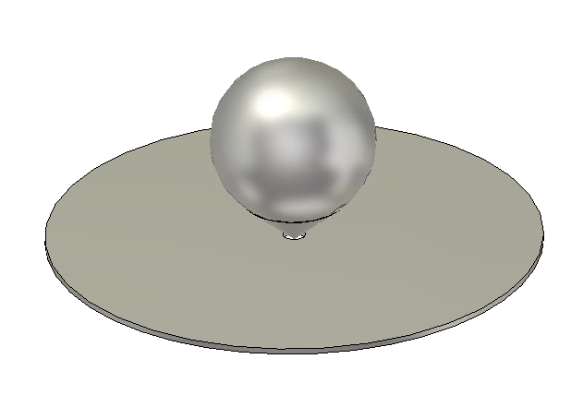
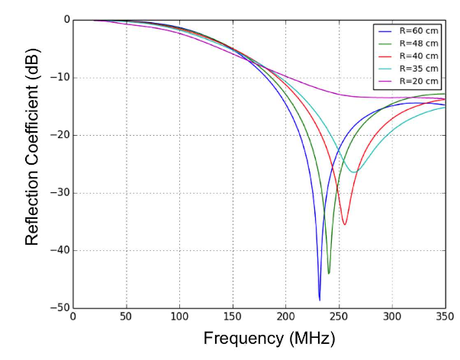
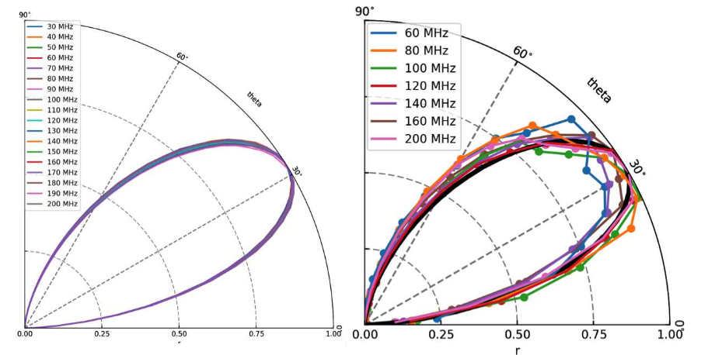
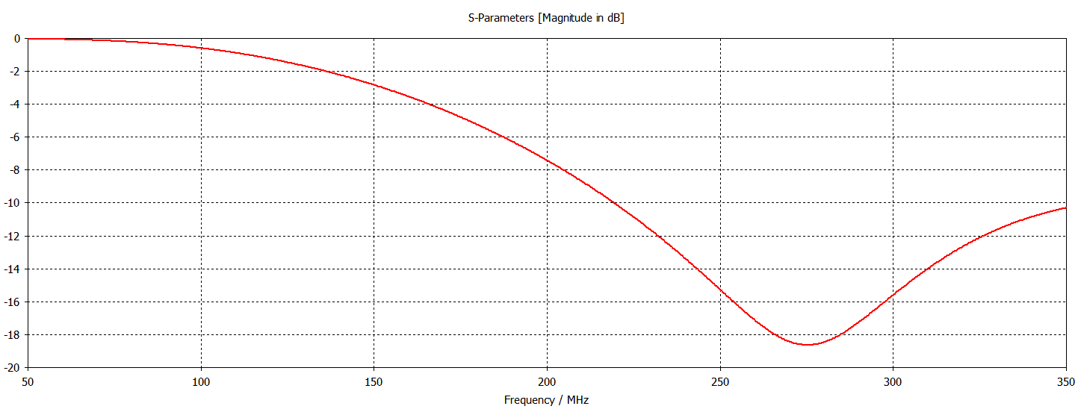
SARAS2 monopole
Cumner
Is designed to function higher than our frequency
band, would need to be scaled up.
Possible -30dB S11m, and uniform farfields
Taken from Singh et al 2017 https://arxiv.org/pdf/1710.01101.pdf

Slide 7
SARAS2 monopole, style
Cumner
PROs | CONs
Monopole, so no balun | Needs scaling to our band
Uniform farfields | Unpolarized
Match-able input impedance (at higher frequencies)
Low feedpoint

Slide 8
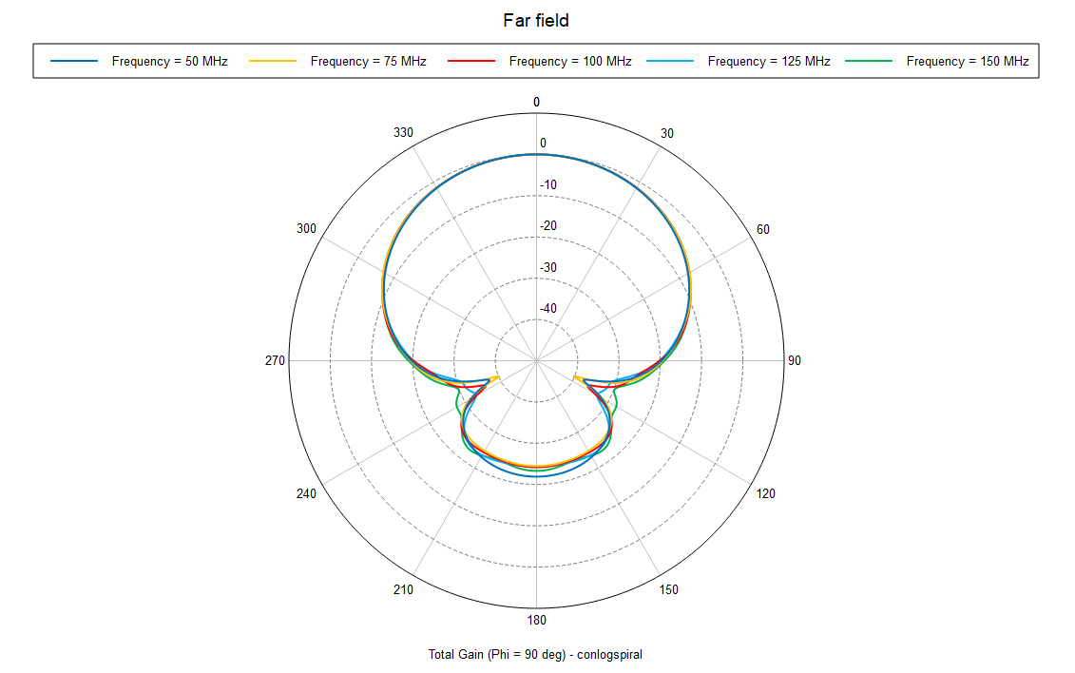
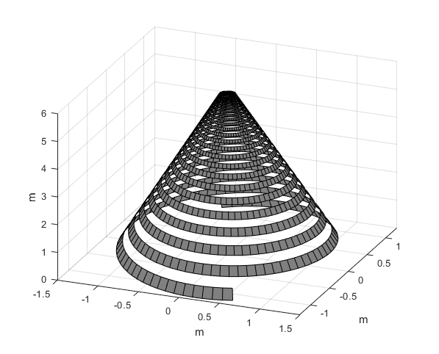
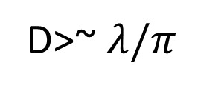

Conical log spiral
Gueuning
D>~ $λ/π$
Constant across all band
$$H\sim λ$$
-20/30 dB backward -> better than a ground plane

Slide 9
Conical log spiral
Gueuning
PROs | CONs
Very low beam chromaticity | Matching circuit
No ground plane | 1 pol
Flat input impedance | Few meters high
Wire version (simple)
Cover all band
lossless broadband tapered matching circuit along the apex of the cone (e.g. coax to parallel wire transformer)
RF system on the ground inside the spiral ?

Slide 10
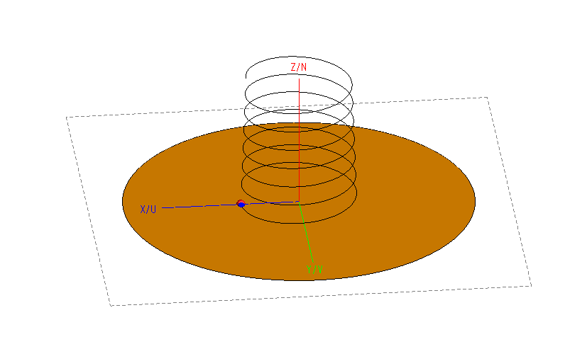
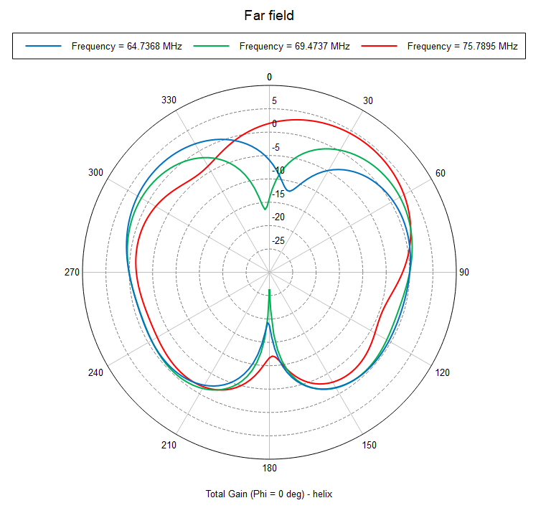
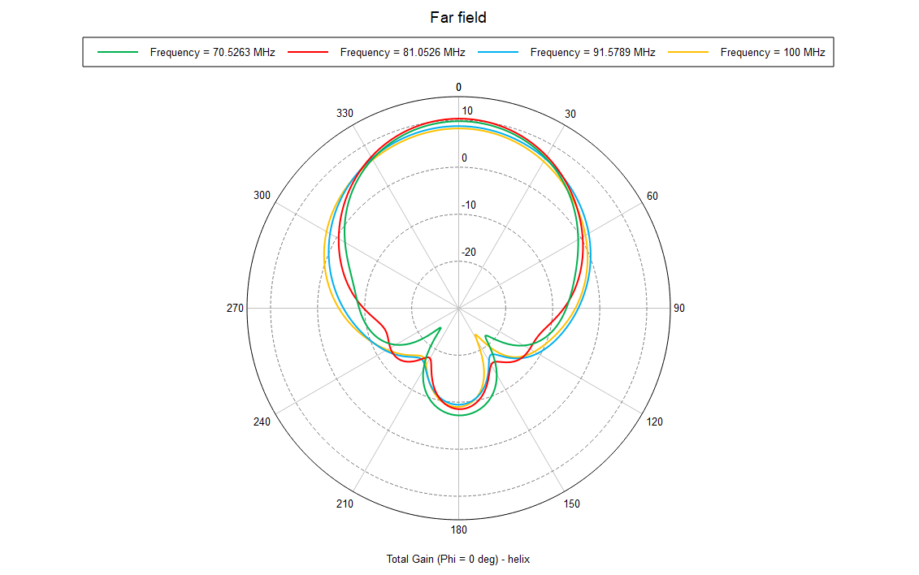

Helical antenna
Gueuning
Monopole mode Travelling wave mode
(D<< $λ$) (D~ $λ/π)$
-20 dB backward
20-30% bandwidth
A lot of power is diffracted toward ground ! + small bandwidth

Slide 11
Gueuning
Helical antenna (traveling wave mode)
PROs | CONs
Smaller ground plane (directive antenna) | Bandwidth (S11=-15 dB) max 25-30 %
Input impedance potentially tunable down to 50 Ohm | 1 pol
Pencil beam

Slide 12
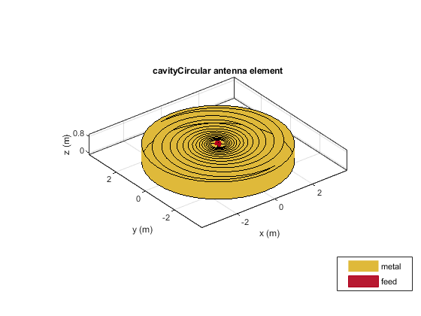
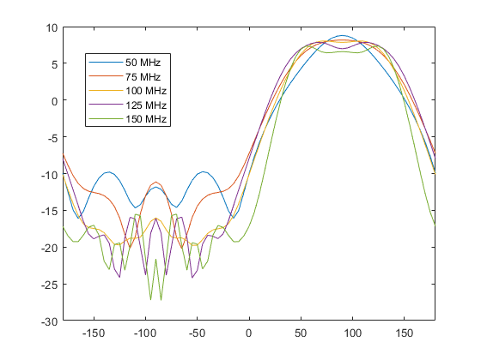
Cavity-backed flat spiral
Gueuning
The cavity destroy the frequency independent property of the spiral

Slide 13
Additional designs
Sinuous antenna
Inverted Vivaldi feed, possibly with shielding
Horn antenna
HIBiscus antenna (https://ieeexplore.ieee.org/stamp/stamp.jsp?arnumber=8072391)

